Slide 1


Experiences on prevention and control of congenital Chagas disease: ITALY
Dr Andrea Angheben
Dr Paola Rodari
Dr Federico Gobbi
Dr Lorenzo Zammarchi
Prof Alessandro Bartoloni
Dr Marco Rizzi
Dr Serena Venturelli
https://www.slidescarnival.com/category/free-templates

Slide 2
- Presentation of the group, network and institutions
- Epidemiological context and health system
Legal and normative framework (laws and/or protocols…)
- Biomedical and psychosocial strategies
- Laboratory protocol and internal and external quality control
- Information system, epidemiological variables and case notification

Slide 3

CONTEXT Presentation of the group, network and institutions
2

Slide 4

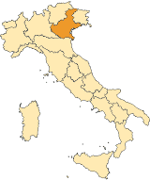
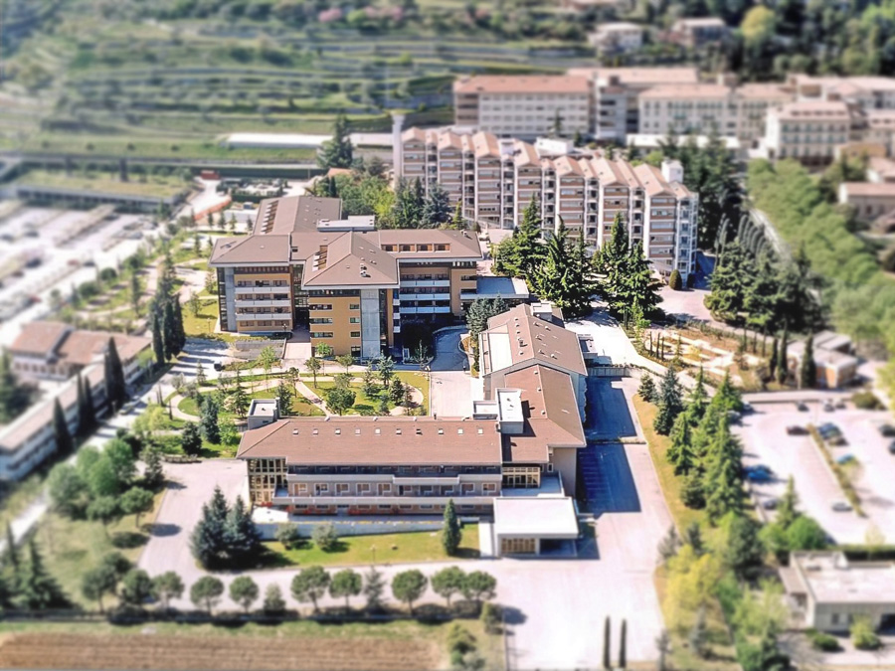

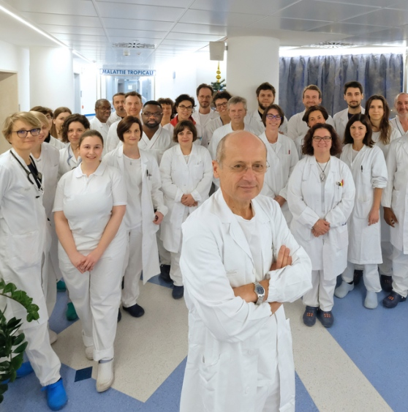



Negrar
Representative: dr Andrea Angheben
(with Prof Zeno Bisoffi, Dr Paola Rodari, Dr Federico Gobbi)
Activities:

Slide 5

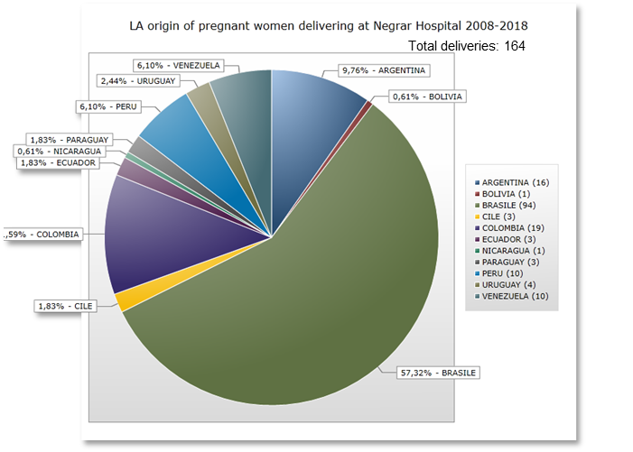
Profile
Afferent population
(2017)
Veneto: population 4,9 million
Verona Province: 0,9 million
Migrants: 487.864 (9,9%) of which 3,5% LAs (11458); Brazil 5046 (44%), Colombia 1708 (15%), Peru 1417 (12%), Ecuador 1059 (9%).
Main scopes and activities
Since 1999 serological tests for CD available for diagnosis at IRCCS Sacro Cuore Hospital (ELISA crude, Recombinant, WB, qPCR, ICT)
2005-2018: 391 Chagas diseases cases (chronic or indeterminate) managed, more than 4900 tests done
Since 2008 free serology for CD offered to all LA pregnant women in addition to TORCH
Education/Promotion (AILMAC Onlus), Equipo Chagas (travelling) many screening session in different cities in Northern Italy (2-3 times a year since 10 years
On cChagas disease
2008-2018
Delivery of LAs women at Negrar Hospital: 164. deliveries in 131 women)
Coverage rate serological screening 49% (64/131)
Pregnant women with CD 0
CD prevalence 0%
Mangiagalli clinic – Milan screening 3+/214=1,4% (2 Bolivians, 1 paraguay)
Negrar pregnant screening not delivery 18, 0%+

Slide 6
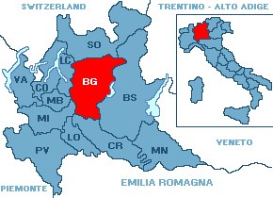



Bergamo
Representative:
Dr Serena Venturelli
(with Dr Marco Rizzi, dr Paola Rodari)
Progetto Cuore Chagas

Slide 7


Profile
Afferent population
(June 2017)
Lombardy: population 10.03 million
Bergamo Province: 1.1 million
Migrants: 125,500 of which 6080 are Bolivians (but around 10,000 if considering undocumented).
Bolivians in Bergamo are 42.6% of all Bolivians resident in Italy
Main scopes and activities
All 8 hospitals offering antenatal and delivery care in Bergamo Province involved
Since Oct 2013 serology for CD offered to all Bolivian women in addition to TORCH
Test di screening chemiluminescent immunoassay (ChLIA), confirmatory test chemiluminescent microparticle immunoassay (CMIA)
Positive mothers: clinical ev, ECG and echocardiogram, GI evaluations if symptoms, treatment with benznidazole once breastfeeding stopped
Newborn: clinical ev, direct blood smear examination +microhaematocrit at birth and 1 month old, sierologigy at 0, 1, 6, 9 months . If infected treatment with benznidazole
Since Mar 2015 dedicated outpatient clinic for adults (screening and treatment for LA adults)
On Chagas disease
2014-2016 period (3y)
Delivery in Bolivian women ~130 per year (387 deliveries in 376 women)
Coverage rate serological screening 85.6% (322/376)
Pregnant women with CD 28
CD prevalence 8.7%
Children born to positive mothers: 29 (included one pair of twins) :
22 children negative to screening
1 child infected
3 children currently under monitoring
3 children lost to follow up
Adherence rate to follow up 88.5%
Transmission rate 4.3% (1/23, 95% IC 0-12.6)

Slide 8
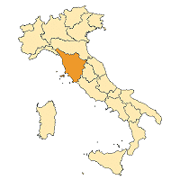






Tuscany Region
Representative: dr Lorenzo Zammarchi
(with Prof Alessandro Bartoloni)

Slide 9
Profile
Afferent population
(Dec 31st, 2017)
Tuscany: population 3,7 million
Latin American 23,746 (0.6% of Tuscan population); 62% female; 53% in Florence province; 9% Leghorn province
Citizenship: [Peru 10,444; Brazil 3,577; Rep Dom 2,570; Cuba 1,733; Ecuador 1,325; Colombia 1,013; Argentina 498; Honduras 482; Venezuela 454; Boliva 330; others 1320]
Delivery in of LA women ~400 per year
CD estimated prevalence 1.75-5% [Shmunis 2010 - PAHO 2006]
Estimated pregnant women with CD/year 7-20
Estimated congenital CD: 1 case every 1-3 year (estimanted transmission risk 5%)
On Chagas disease
Since 2000 serological tests for CD available for diagnosis at AOU Careggi, Florence
2007-2018: 20 Chagas diseases cases (chronic or indeterminate) managed at the AOU Careggi
Tuscany Regional Deliberation n°489, June 4th, 2012: screening in pregnancy for Latin American women (and women born from Latin American mothers). Text of the protocol avilable online *.
Long process
Multidisciplinary (ID specialists, gynecologists, pediatricians, microbiologist, midwives, publich health specialists)
Serology centralized (all test to 1 laboratory in Careggi)
Free test in pregnancy, but should be “actively” prescribed by the gynecologist/general practitioner (code “M50” to provide no-co-payment)
Implemented at Careggi, Florence (not yet extensively implemented in other provinces)
Since 2013 external quality control (Programa Nacional de Controle de Qualidade, Brazil) at Careggi
Three different tests available in Careggi (T.cruzi ELISA test System(Ortho-Clinical-Diagnostics USA); Architect Chagas (Abbott); BioElisa Chagas (Biokit-SPA-Barcellona)
2018 uptated version of the protocol will be available soon
2019 Regional Education Courses will be implemented
Results 2012-2017: ~total 300 women screened; estimated coverage 12-13% in Tuscany, 71% in Careggi; 3 women positive; 6 “exposed”children followed –up (1 women had 3 children, 1 women had 2 children)
http://demo.istat.it/str2017/index.html
* http://www.regione.toscana.it/documents/10180/13326766/Allegato+parere+n.+46-2015+Prev+e+conrollo+malattia+di+Chagas.pdf/a91b89ec-2366-4abf-8646-ba65a543e025?version=1.0
Notes:
Calcoli:
400 parti l’anno di LA in Toscana
70 parti l’anno di LA a Careggi
50 partorienti LA testate all’anno a Carreggi
Totale donne testate (2012-2017) 50 x 6 =300
Copertura Toscana 50/400= 12.5%
Copertura Careggi 50/70= 71%

Slide 10







Other actors, Italy
Milan
Genova
Rome
X
Rome

Slide 11
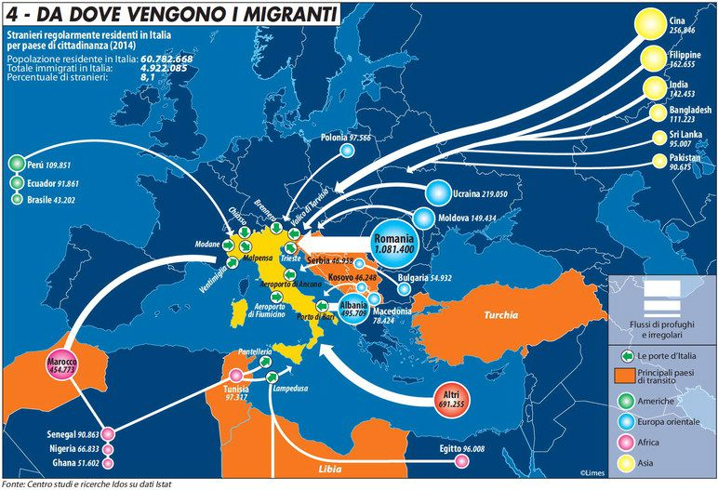

Slide 12
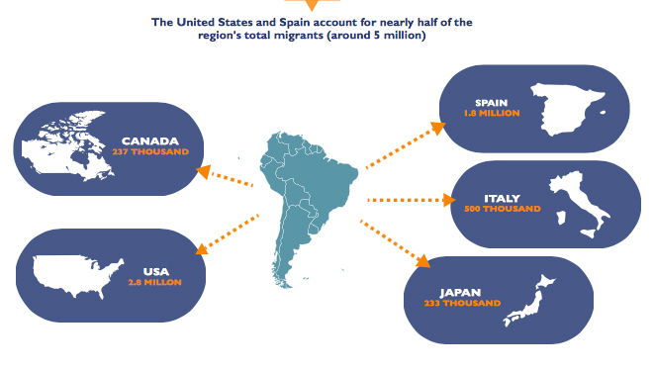
Latin American migrant

Slide 13
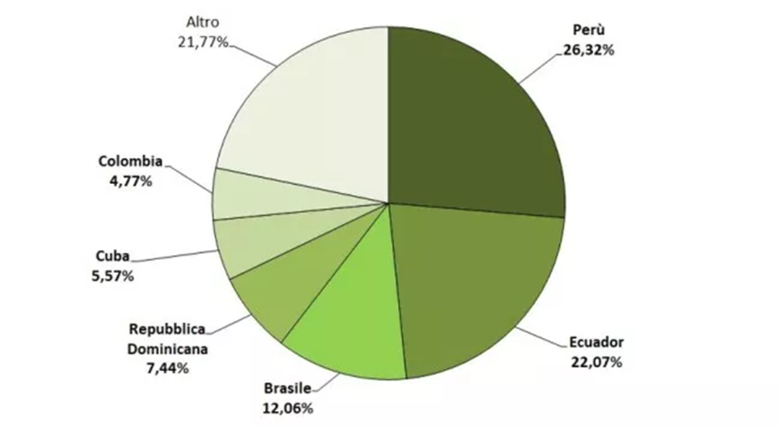
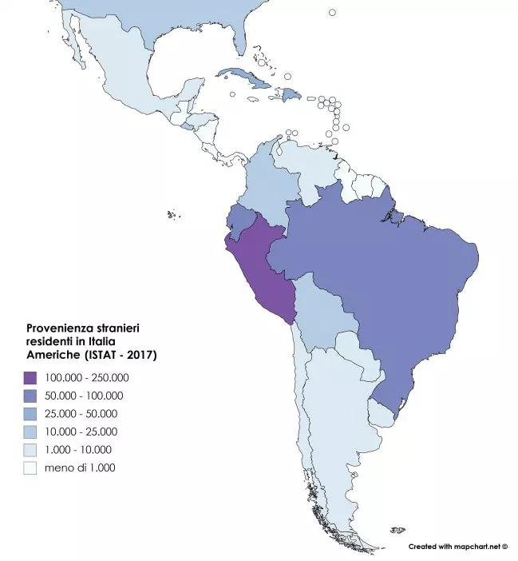
From where in Latin America, how many

Slide 14
Epidemiological context and health system
2

Slide 15

Latin American communities patchy distributed across the country Sanitary system with a federal development → difficult to have a national plan of control → 6-12000 cases estimated, around 600 diagnosed/treated (5-10%) → hidden migrants (migration Italy-LA, LA-Italy)

Slide 16
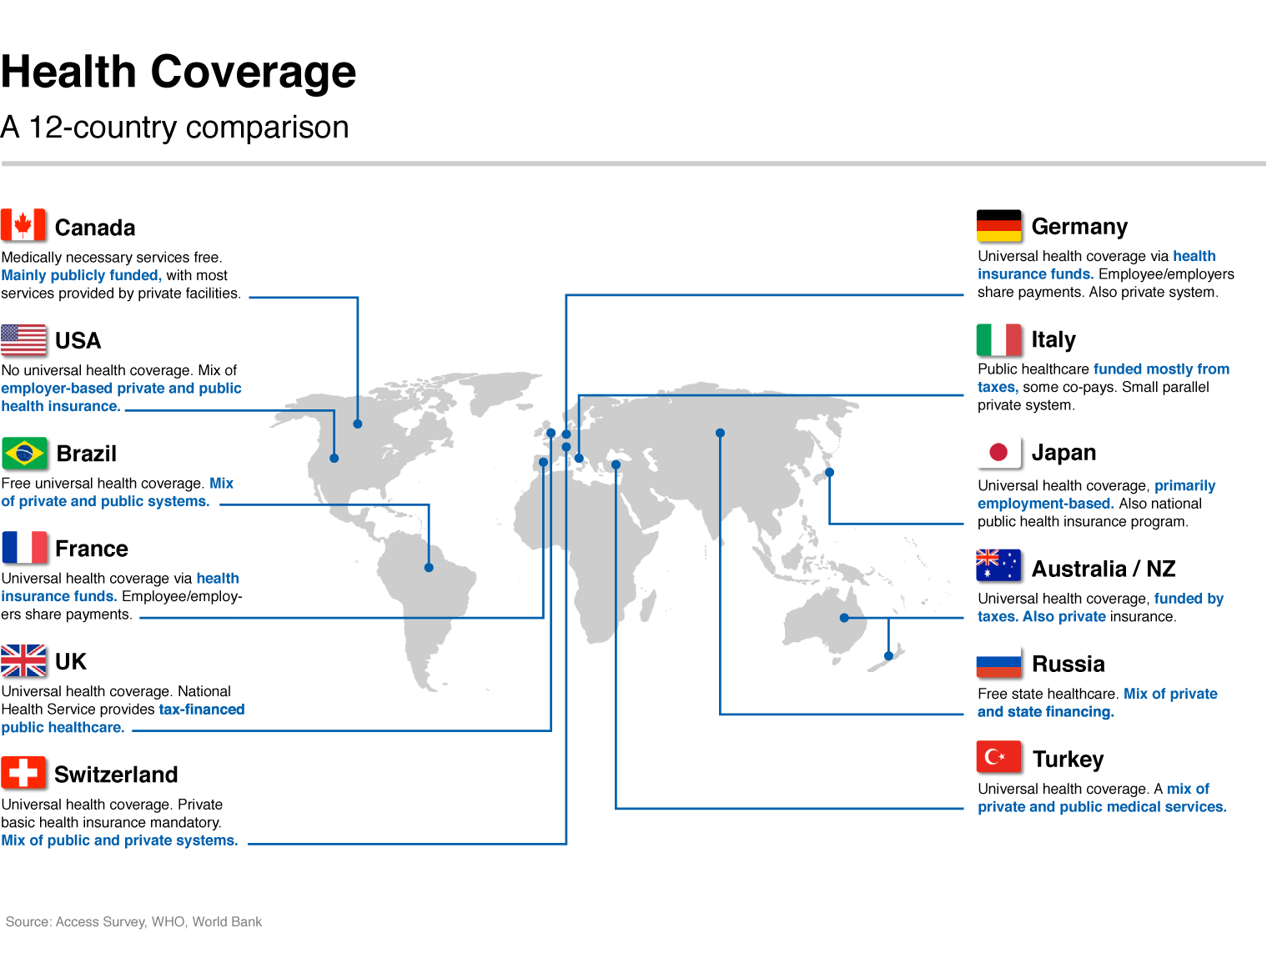

Slide 17
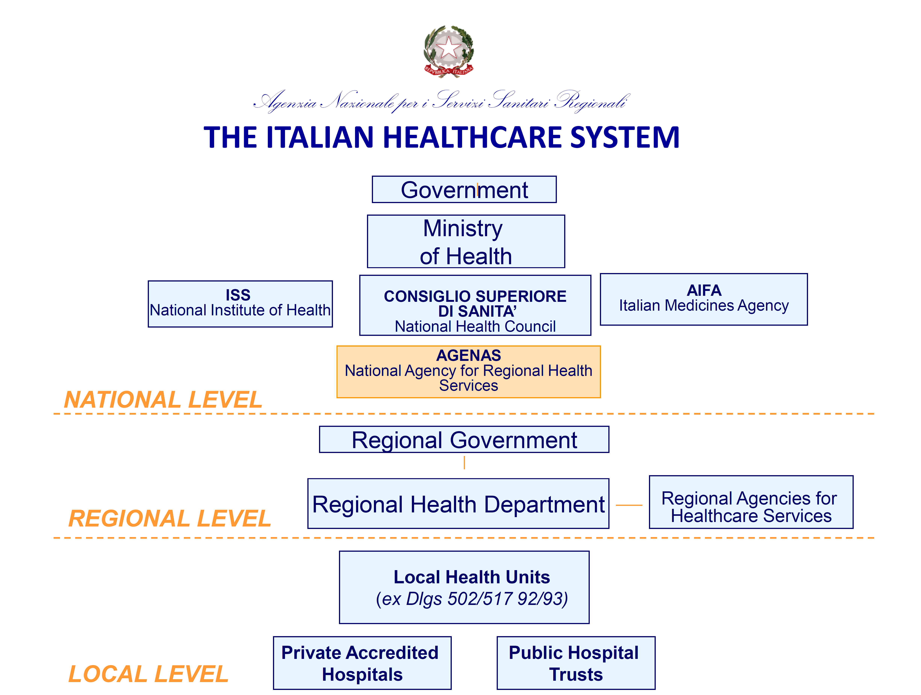

Slide 18
Strenghts of the Italian National Health System
The Italian National Health Service was established on December 23rd 1978 end approved by 85% of the Parliament (L.833/78).
The NHS is founded on the principles of universal coverage, social financing through the use of general taxation and non-discriminatory access to the health care services.
From this Act onward, the history of public health is solidly integrated with the Constitution of our country, with its civil and democratic growth and its economic and social development.
This pathway included the creation of the system based on “healthcare trusts” in order to foster efficiency and managerial skills, ensuring provision of healthcare basket benefits (so called LEA) homogenously within the national territory.

Slide 19
Features and Criticisms
No plan on NTDs
Chagas disease (also congenital control) diagnosis not free (ticket=contribution of patient)
Essential Levels of Assistance (LEA) not containing CD, even congenital or pediatric
Some programs (Tuscany) offer free test during pregnancy
When diagnosed CD can be treated for free in Hospital, at low charge as out-patient (drug free, exams with ticket)

Slide 20
Legal and normative framework (laws and/or protocols…)
3

Slide 21
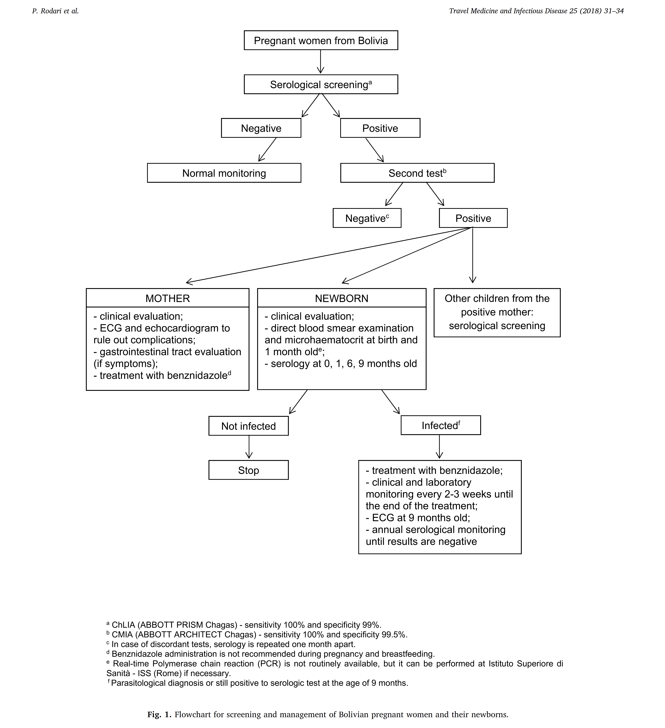
“SCREENING E PERCORSO DI CURA PER LA CARDIOMIOPATIA DA MALATTIA DI CHAGAS NELLE DONNE DI ORIGINE LATINOAMERICANA IN ETA’ FERTILE”);
Operation protocol of screening and managment of Chagas disease

Slide 26
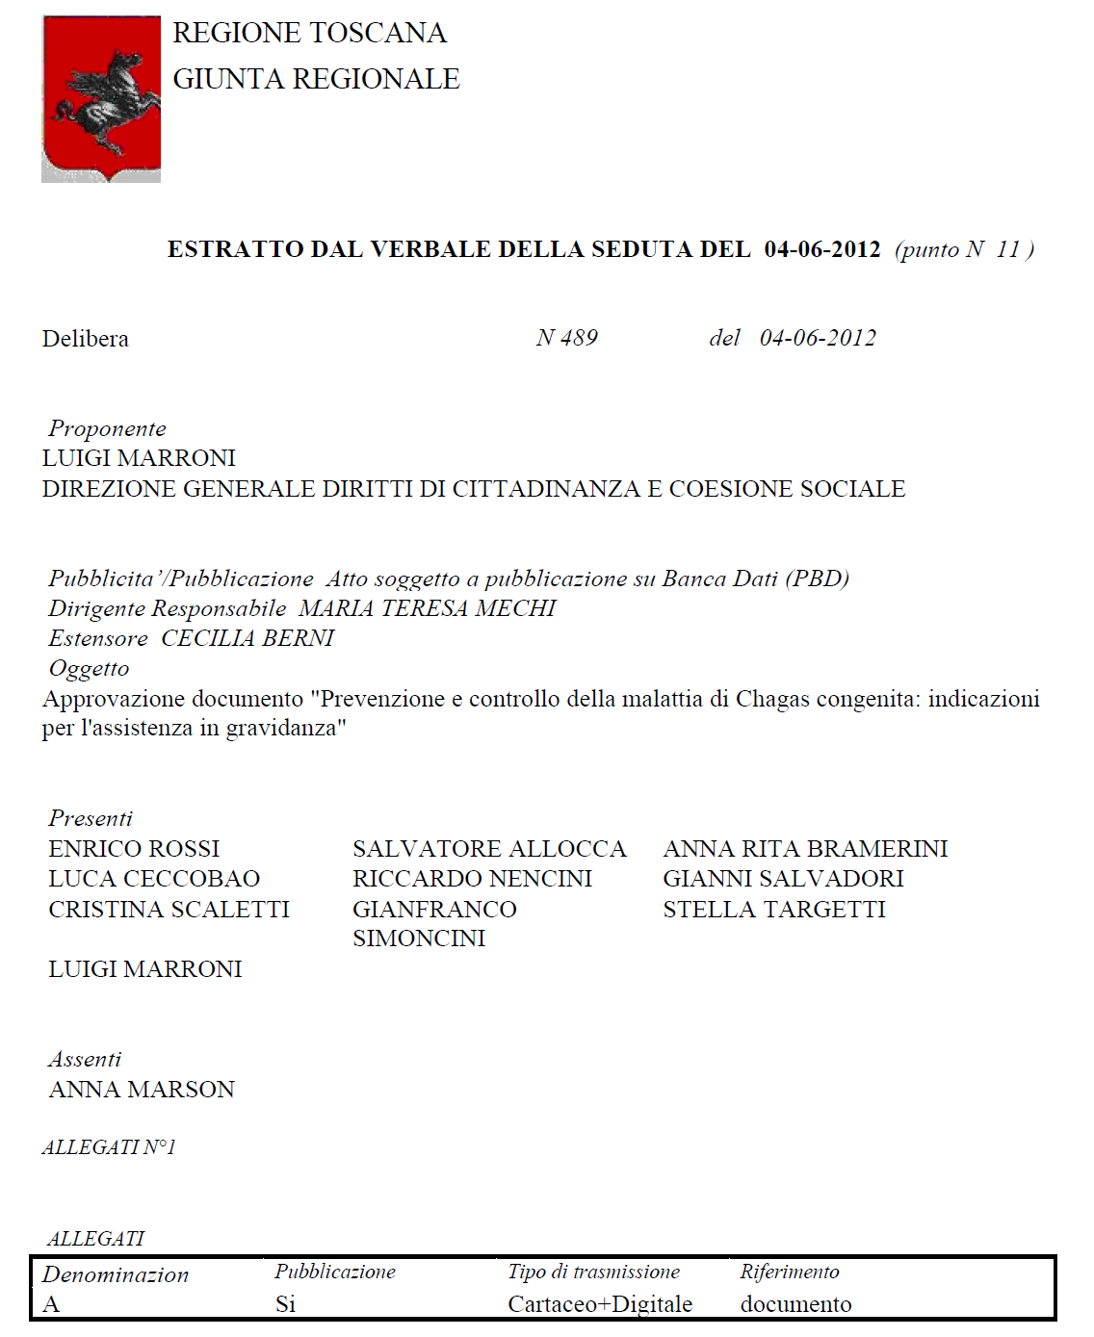
Tuscany Regional Deliberation n°489

Slide 27
Program Chagas in pregnancy - Tuscany
Offer of the screening at first access (when the pregnancy booklet is given to the woman)
Prescription of the Chagas test
During pregnancy test is done
Test result
If +, pt is referred to the Regional Centre for Tropical Diseases (Florence)
Evaluation and follow-up of the newborn if mother affected

Slide 28
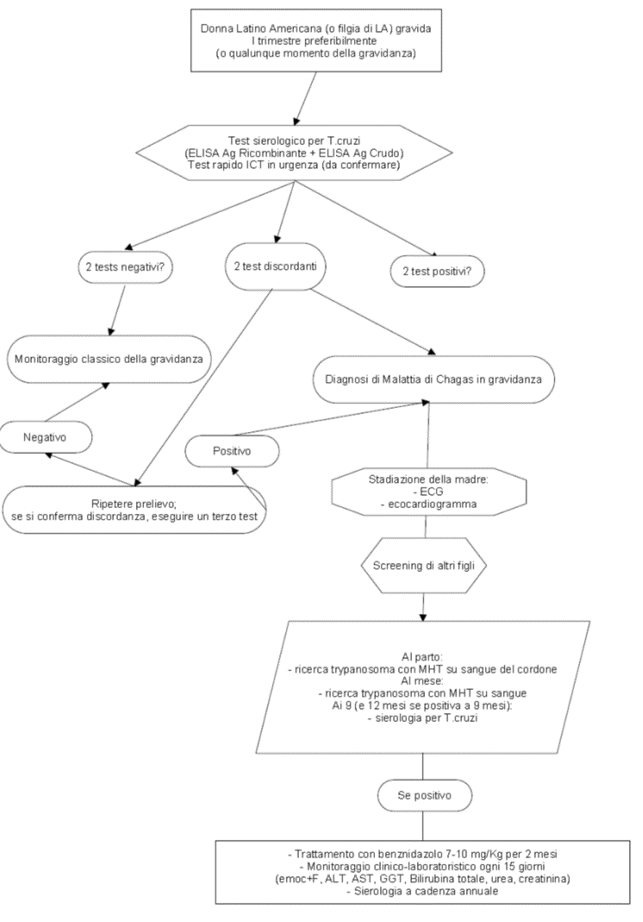
Negrar internal protocol

Slide 29
Biomedical and psychosocial strategies
4

Slide 30

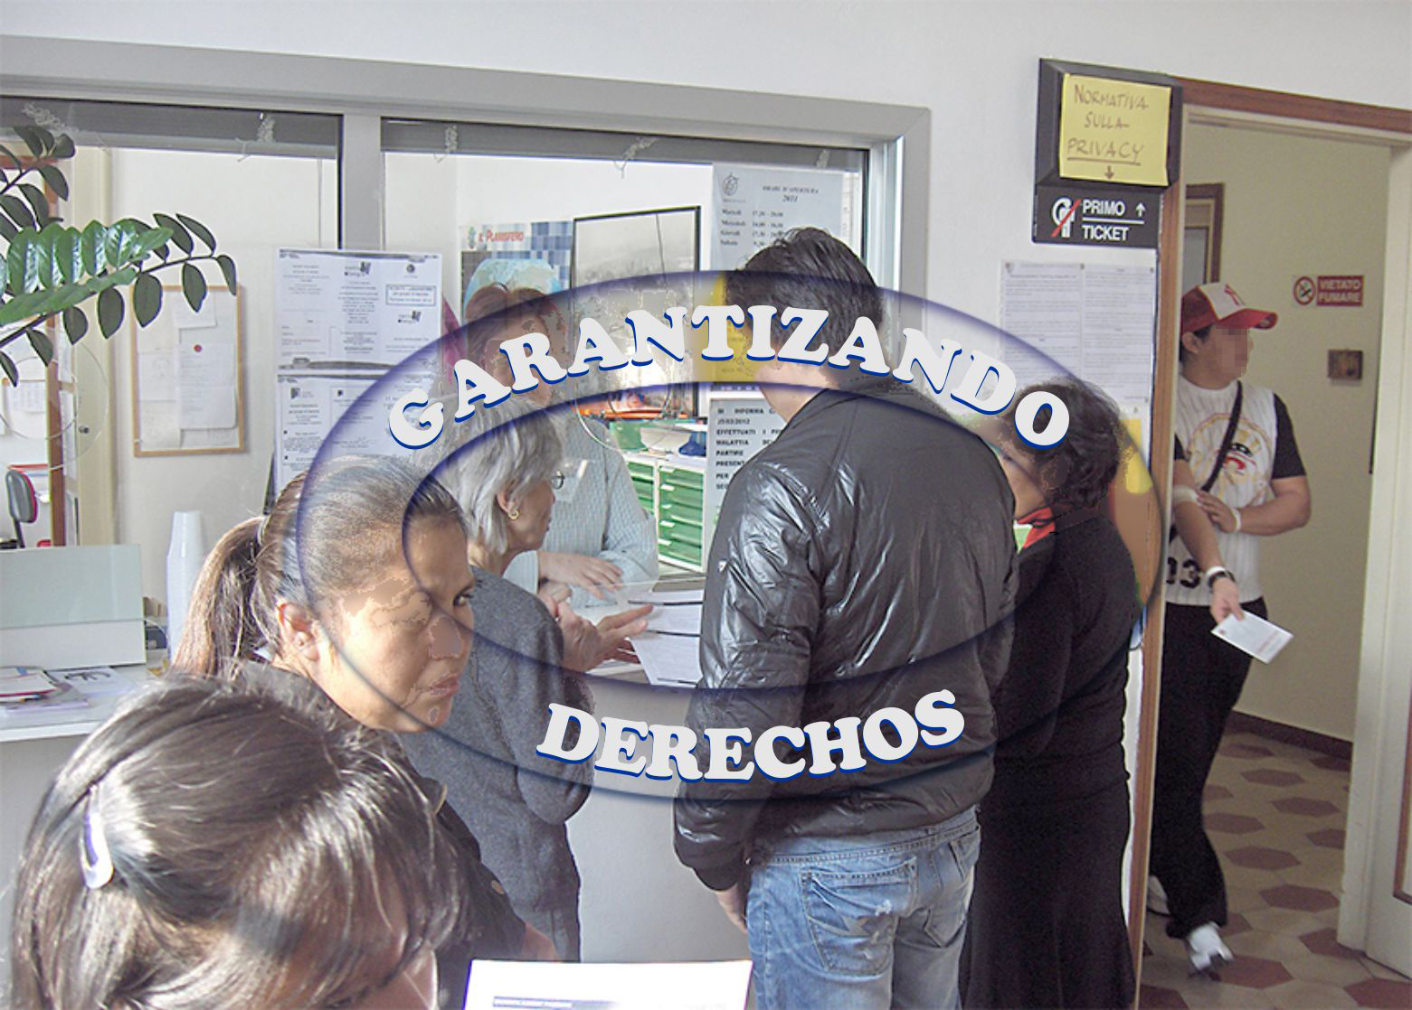
Virtuous process
LA communities
Public Health
Institutions
NGOs, Access groups (Equipo Chagas)
Education/Implementation
Women (communities) in the center
AILMAC promoting (education and screening sessions)
Involvment of communities and actors

Slide 31
Laboratory protocol and internal and external quality control
5

Slide 32

Quality control
Internal quality control
Esternal quality control (Brazil → PNCQ since 2013 Negrar-Tuscany; NEQAS → Bergamo)

Slide 33
Information system, epidemiological variables and case notification
6

Slide 34
Cases notification
Not mandatory for Chagas nor for cCh
But possibile!
It is recommended in the framework of the congenital transmission control

Slide 35

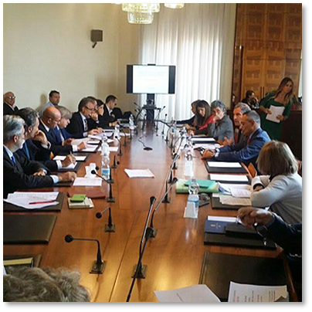
Italy
Working on cCh
Suggestions and proposals
Women as an entry door to achieve cCh control
Recommendaton of the need to establish free access to diagnosis for at risk women (in childbearing age and pregnancy)
How? LEA revision* → ToRCh² or at least at Regional level
Need of lobbying and Public Health Institutions recommendation, evaluating different scenarios (MoH, ECDC).
*

Slide 36
Recommendations aims:
Expanded ToRCH free screening→ ToRCH²
Toxoplasmosis, Rosolia, Citomegalovirus, Herpes (+HIV, syphilis AND Chagas) → expert recommendation to offer free access to diagnosis for at-risk women in childbearing age or pregnant…
…

